Slide 1

Unit-4
Object-Oriented Programming
2305CS102
Prof. Swati R Sharma
Computer Engineering Department
swati.sharma@darshan.ac.in

Slide 2
Unit-4(part-1) Exception Handling
Object-Oriented Programming
2305CS102
Prof. Swati R Sharma
Computer Engineering Department
swati.sharma@darshan.ac.in

Slide 3
Syllabus
Sr. | Content | T Hrs | W %
1 | Introduction to JAVA | 10 | 20
2 | Object Oriented Concepts | 15 | 22
3 | Inheritance and Abstraction | 12 | 20
4 | Package, Exception Handling and Multithreading | 13 | 20
5 | IO Programming and Collection Framework | 10 | 18

Slide 4
Unit-4 Exception Handling

Looping
What we will learn
Exception and Error
try, catch, throw, throws and finally
Built in exception
Custom exception

Slide 5

Exception Handling

Slide 6
Exceptions
An exception is an object that describes an unusual or erroneous situation.
Exceptions are thrown by a program, and may be caught and handled by another part of the program.
A program can be separated into a normal execution flow and an exception execution flow.
An error is also represented as an object in Java, but usually represents a unrecoverable situation and should not be caught.
Java has a predefined set of exceptions and errors that can occur during execution.
A program can deal with an exception in one of three ways:
ignore it
handle it where it occurs
handle it at another place in the program
The manner in which an exception is processed is an important design consideration.

Slide 7

Exception Handling in Java

Slide 8
Using try and catch
Example:
Multiple catch:
Exception is the superclass of all the exception that may occur in Java
try{
// code that may cause exception
}
catch(Exception e){
// code when exception occurred
}
try{
// code that may cause exception
}
catch(ArithmeticException ae){
// code when arithmetic exception occurred
}
catch(ArrayIndexOutOfBoundsException aiobe){
// when array index out of bound exception occurred
}

Slide 9
Nested try statements
try
{
try
{
// code that may cause array index out of bound exception
}
catch(ArrayIndexOutOfBoundsException aiobe)
{
// code when array index out of bound exception occured
}
// other code that may cause arithmetic exception
}
catch(ArithmeticException ae)
{
// code when arithmetic exception occurred
}

Slide 10
Types of Exceptions
An exception is either checked or unchecked.
Checked Exceptions
A checked exception either must be caught by a method, or must be listed in the throws clause of any method that may throw or propagate it.
The compiler will issue an error if a checked exception is not caught or asserted in a throws clause
Example: IOException, SQLException etc…
Unchecked Exceptions
An unchecked exception does not require explicit handling, though it could be processed using try catch.
The only unchecked exceptions in Java are objects of type RuntimeException or any of its descendants.
Example: ArithmeticException, ArrayIndexOutOfBoundsException, NullPointerException etc..

Slide 11
The Exception Class Hierarchy
Classes that define exceptions are related by inheritance, forming an exception class hierarchy.
All error and exception classes are descendants of the Throwable class
The custom exception can be created by extending the Exception class or one of its descendants.
LinkageError
ArithmeticException
VirtualMachineError
NullPointerException
Error
AWTError
ArrayIndexOutOfBoundsException
Throwable
Unchecked Exception
IllegalArgumentException
RuntimeException
Exception
. . .
AWTException
InterruptedIOException
IOException
EOFException
Checked Exception
FileNotFoundException
. . .

Slide 12
Java’s Inbuilt Unchecked Exceptions
Exception | Meaning
ArithmeticException | Arithmetic error, such as divide-by-zero.
ArrayIndexOutOfBoundsException | Array index is out-of-bounds.
ClassCastException | Invalid cast.
IllegalArgumentException | Illegal argument used to invoke a method.
IllegalThreadStateException | Requested operation not compatible with current thread state.
IndexOutOfBoundsException | Some type of index is out-of-bounds.
NegativeArraySizeException | Array created with a negative size.
NullPointerException | Invalid use of a null reference.
NumberFormatException | Invalid conversion of a string to a numeric format.
StringIndexOutOfBounds | Attempt to index outside the bounds of a string.

Slide 13
Java’s Inbuilt Checked Exceptions
Exception | Meaning
ClassNotFoundException | Class not found.
IOException | Input Output Exceptions
CloneNotSupportedException | Attempt to clone an object that does not implement the Cloneable interface.
IllegalAccessException | Access to a class is denied.
InstantiationException | Attempt to create an object of an abstract class or interface.
InterruptedException | One thread has been interrupted by another thread.
NoSuchFieldException | A requested field does not exist.
NoSuchMethodException | A requested method does not exist.

Slide 14
Checked vs. Unchecked Exception
UnChecked Exception | Checked Exception
An unpredictable error present in the logic that may arise during runtime. | Predictable error associated with normal usage of third party tools or API.
Associated with Runtime exceptions. | Not associated with Runtime exceptions.
Exception Handling Semantics not required | Must be handled by a try-and-catch block, or be thrown by the invoking method
Can be customized by extending Runtime Exception | Can be customized by extending java.lang.Exception
Example: NullPointerException, ClassCastException, ArithmeticException, DateTimeException, ArrayStoreException | Example: ClassNotFoundException, SocketException, SQLException, IOException, FileNotFoundException

Slide 15
throw statement
It is possible for your program to throw an exception explicitly, using the throw statement.
The general form of throw is shown here:
throw ThrowableInstance;
Here, ThrowableInstance must be an object of type Throwable or a subclass of Throwable.
Primitive types, such as int or char, as well as non-throwable classes, such as String and Object, cannot be used as exceptions.
There are two ways you can obtain a Throwable object:
using a parameter in a catch clause,
or creating one with the new operator.

Slide 16
Throw (Example)
public class DemoException {
public static void main(String[] args) {
int balance = 5000;
Scanner sc = new Scanner(System.in);
System.out.println("Enter Amount to withdraw");
int withdraw = sc.nextInt();
try {
if(balance - withdraw < 1000) {
throw new Exception("Balance must be grater than 1000");
}
else {
balance = balance - withdraw;
}
}catch(Exception e) {
e.printStackTrace();
}
}
}

Slide 17
The finally statement
public class MainCall {
public static void main(String args[]) {
int balance = 5000;
Scanner sc = new Scanner(System.in);
System.out.println("Enter Amount to withdraw");
int withdraw = sc.nextInt();
try {
if(balance - withdraw < 1000) {
throw new Exception("Balance < 1000 error");
}
else {
balance = balance - withdraw;
}
}catch(Exception e) {
e.printStackTrace();
}
finally {
sc.close();
}
}
}
The purpose of the finally statement will allow the execution of a segment of code regardless if the try statement throws an exception or executes successfully
The advantage of the finally statement is the ability to clean up and release resources that are utilized in the try segment of code that might not be released in cases where an exception has occurred.

Slide 18
throws statement
A throws statement lists the types of exceptions that a method might throw.
This is necessary for all exceptions, except those of type Error or RuntimeException, or any of their subclasses.
All other exceptions that a method can throw must be declared in the throws clause. If they are not, it will result into a compile-time error.
This is the general form of a method declaration that includes a throws clause:
type method-name(parameter-list) throws exception-list {
// body of method
}
Here, exception-list is a comma-separated list of the exceptions that a method can throw.
Example :
void myMethod() throws ArithmeticException, NullPointerException
{
// code that may cause exception
}

Slide 19
Methods of Exception class
Method | Description
Throwable fillInStackTrace( ) | Returns a Throwable object that contains a completed stack trace. This object can be rethrown.
Throwable getCause( ) | Returns the exception that underlies the current exception. If there is no underlying exception, null is returned.
String getMessage( ) | Returns a description of the exception.
StackTraceElement[ ] getStackTrace( ) | Returns an array that contains the stack trace, one element at a time, as an array of StackTraceElement.
Throwable initCause(Throwable causeExc) | Associates causeExc with the invoking exception as a cause of the invoking exception. Returns a reference to the exception.
void printStackTrace( ) | Displays the stack trace.
void printStackTrace(PrintStream stream) | Sends the stack trace to the specified stream.
void setStackTrace(StackTraceElement elements[ ]) | Sets the stack trace to the elements passed in elements.
String toString( ) | Returns a String object containing a description of the exception.

Slide 20
Custom Exception
Create your own Exception

Slide 21
Create Your Own Exception
Although Java’s built-in exceptions handle most common errors, you will probably want to create your own exception types to handle situations specific to your applications.
This is quite easy to do: just define a subclass of Exception (which is, of course, a subclass of Throwable).
The Exception class does not define any methods of its own. It does inherit those methods provided by Throwable.
Thus, all exceptions have methods that you create and defined by Throwable.

Slide 22
Custom Exception (Example)
// A Class that represents user-defined exception
class MyException
extends Exception
{
public MyException(String s)
{
// Call constructor of parent (Exception)
super(s);
}
}
class MainCall {
static int currentBal = 5000;
public static void main(String args[]) {
try {
int amount = Integer.parseInt(args[0]);
withdraw(amount);
} catch (Exception ex) {
System.out.println("Caught");
System.out.println(ex.getMessage());
}
}
public static void withdraw(int amount) throws Exception
{
int newBalance = currentBal - amount;
if(newBalance<1000) {
throw new MyException("Darshan Exception");
}
}
}

Slide 23
Unit-4: Package (Part-2)
Object-Oriented Programming
2105CS102
Prof. Swati R Sharma
Computer Engineering Department
swati.sharma@darshan.ac.in

Slide 24
Syllabus
Sr. | Content | T Hrs | W %
1 | Introduction to JAVA | 10 | 20
2 | Object Oriented Concepts | 15 | 22
3 | Inheritance and Abstraction | 12 | 20
4 | Package, Exception Handling and Multithreading | 13 | 20
5 | IO Programming and Collection Framework | 10 | 18

Slide 25
Unit-4 Package

Looping
What we will learn
Introduction to Package
Use of package
CLASSPATH
Import statement
Static import
Access control

Slide 26

Package
Let’s bundle it!

Slide 27
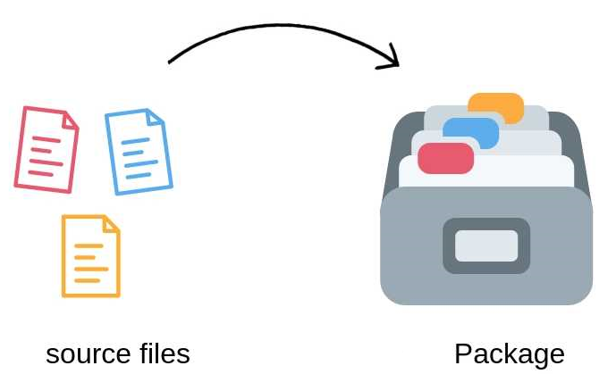
Introduction to Package
Packages are containers for classes that are used to keep the class name space compartmentalized.
For example, a package allows you to create a class named List, which you can store in your own package without concern that it will collide with some other class named List stored elsewhere.
Packages are stored in a hierarchical manner and are explicitly imported into new class definitions.
Java provides a mechanism for partitioning the class name space into more manageable chunks. This mechanism is the package.
You can define classes inside a package that are not accessible by code outside that package.
You can also define class members that are only exposed to other members of the same package.

Slide 28
Package
A Package can be defined as a grouping of related types providing access protection and name space management.
Programmers can define their own packages to bundle group of classes/interfaces, etc.
Packages are used in Java in order to
prevent naming conflicts
control access
make searching/locating of classes/interfaces easier.
It is a good practice to group related classes implemented so that a programmer can easily determine that the classes, interfaces are related.

Slide 29
Creating a package
To create a package you need to write package statement followed by the name of the package.
Syntax : package package_name;
Example :
The package statement should be the first line in the source file.
There can be only one package statement in each source file, and it applies to all types in the file.
If a package statement is not used then the class/interfaces will be put into an unnamed package.
package darshan_student;
class Student {
// code
}

Slide 30
Hierarchy of packages
To create Hierarchy of packages, simply separate each package name from the one above it by use of a period(“.”).
Note: One cannot rename a package without renaming the directory in which the classes are stored.
package pkg1[.pkg2[.pkg3]]; //hierarchy must be reflected in the file system
Example:
package java.awt.image; //needs to be stored in java/awt/…
package java.util.Scanner //needs to be stored in java/util/…

Slide 31
Package (Example)
package myPackage;
public class Animal {
public String name;
public void eat(){
System.out.println("Organic Food !!!!");
}
public static void main(String[] args){
Animal a = new Animal();
a.eat();
}
}
To compile
javac –d . Animal.java
To Run the class file
java myPackage.Animal
.
Represent the current directory

Slide 32
Import keyword
import keyword is used to import built-in and user-defined packages into your java source file so that your class can refer to a class that is in another package by directly using its name.
There are 3 different ways to refer to class/interface that is present in different package
import the class/interface you want to use.
import all the classes/interfaces from the package.
Using fully qualified name.
We can import a class/interface of other package using a import keyword at the first line of code.
Example :
import java.util.Scanner;
public class DemoImport {
public static void main(String[] args)
{
Scanner s = new Scanner(System.in);
// Code
}
}

Slide 33
Import (importing all class/interface)
We can import all the classes/interfaces of other package using a import keyword at the first line of code with the wildcard (*).
Example :
It is possible to use classes from other packages without importing the class using fully qualified name of the class.
Example :
import java.util.*;
public class DemoImport {
public static void main(String[] args)
{
Scanner s = new Scanner(System.in);
Date d = new Date();
// Code
}
}
java.util.Scanner s = new java.util.Scanner(System.in);

Slide 34
Create and import Package
PackageCreateDemo.java
package darshan;
public class PackageCreateDemo{
public static void main(String[] args) {
System.out.println("hello");
}
public void add(){
System.out.println("calling package()");
}
}
Output
F:\Prog>javac -d . PackageCreateDemo.java
PackageImportDemo.java
import darshan.PackageCreateDemo;
public class PackageImportDemo{
public static void main(String[] args) {
System.out.println("Inside PackageImportDemo");
PackageCreateDemo pc=new PackageCreateDemo();
pc.add();
}
}
Output
F:\Prog>javac PackageImportDemo.java
F:\Prog>java PackageImportDemo
Inside PackageImportDemo
calling package()

Slide 35
Access Control

Slide 36
Access Control
Access Modifier | Description
Private(-) | The access level of a private modifier is only within the class. It cannot be accessed from outside the class.
Default(~) | The access level of a default modifier is only within the package. It cannot be accessed from outside the package. If you do not specify any access level, it will be the default.
Protected(#) | The access level of a protected modifier is within the package and outside the package through child class. If you do not make the child class, it cannot be accessed from outside the package.
Public(+) | The access level of a public modifier is everywhere. It can be accessed from within the class, outside the class, within the package and outside the package.

Slide 37
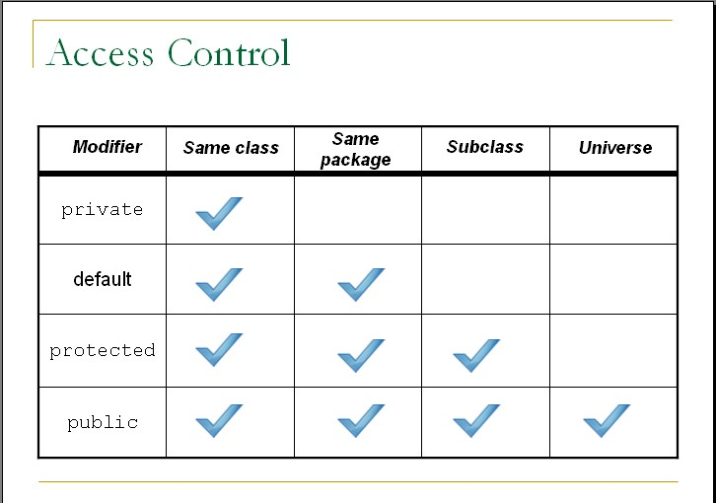
Access Control
Access Modifier | Same Class | Same Package | Sub Class | Universal
Private
Default
Protected
Public

Slide 38
Unit-4.1(Part-3) Multithreading Programming
Object-Oriented Programming
2301CS201
Prof. Swati R Sharma
Computer Engineering Department
swati.sharma@darshan.ac.in

Slide 39
Unit-4.1

Looping
What we will learn
Use of Multithreading Programming
Thread class
Runnable Interface
Executor Framework
Thread priority
Thread synchronization

Slide 40
What is Multithreading?

Slide 41

What is Multithreading?
Multithreading in Java is a process of executing multiple threads simultaneously.
A thread is a lightweight sub-process, the smallest unit of processing.
Multiprocessing and multithreading, both are used to achieve multitasking.
Threads use a shared memory area. They don't allocate separate memory area thus, saves memory and context-switching between the threads takes less time than process.
A thread goes through various stages in its life cycle. For example, a thread is born, started, runs, and then dies.
Lets see the life cycle of the thread.

Slide 42
Life cycle of a Thread

Slide 43
Life cycle of a Thread
There are 5 stages in the life cycle of the Thread
New: A new thread begins its life cycle in the new state. It remains in this state until the program starts the thread. It is also referred to as a born thread.
Runnable: After a newly born thread is started, the thread becomes runnable. A thread in this state is considered to be executing its task.
Waiting: Sometimes a thread transitions to the waiting state while the thread waits for another thread to perform a task. A thread transitions back to the runnable state only when another thread signals waiting thread to continue.
Timed waiting: A runnable thread can enter the timed waiting state for a specified interval of time. A thread in this state transitions back to the runnable state when that time interval expires or when the event it is waiting for occurs.
Terminated: A runnable thread enters the terminated state when it completes its task or otherwise terminates.
new
Program starts
thread
unlock
signal
signalAll
runnable
Thread completes
Task
await
lock
await
sleep
Interval
expires
waiting
timed waiting
terminated

Slide 44
Creating a Thread in Java
There are two ways to create a Thread
extending the Thread class
implementing the Runnable interface

Slide 45
1) Extending Thread Class
One way to create a thread is to create a new class that extends Thread, and then to create an instance of that class.
The extending class must override the run( ) method, which is the entry point for the new thread.
It must also call start( ) to begin execution of the new thread.
class NewThread extends Thread {
NewThread() {
super("Demo Thread");
System.out.println("Child thread: " + this);
start(); // Start the thread
}
public void run() {
try {
for (int i = 5; i > 0; i--) {
System.out.println("Child Thread: " + i);
Thread.sleep(500);
}
} catch (InterruptedException e) {
System.out.println("Child interrupted.");
}
System.out.println("Exiting child thread.");
}}
class ExtendThread {
public static void main(String args[]) {
new NewThread(); // create a new thread
try {
for (int i = 5; i > 0; i--) {
System.out.println("Main Thread: " + i);
Thread.sleep(1000);
}
} catch (InterruptedException e) {
System.out.println("Main thread interrupted.");
}
System.out.println("Main thread exiting.");
}
}

Slide 46
2) Implementing Runnable Interface
To implement thread using Runnable interface, Runnable interface needs to be implemented by the class.
class NewThread implements Runnable
Class which implements Runnable interface should override the run() method which containts the logic of the thread.
public void run( )
Instance of Thread class is created using following constructor.
Thread(Runnable threadOb, String threadName);
Here threadOb is an instance of a class that implements the Runnable interface and the name of the new thread is specified by threadName.
start() method of Thread class will invoke the run() method.

Slide 47
Example Runnable Interface
class RunnableDemo implements Runnable{
Thread t;
RunnableDemo(){
t=new Thread(this,"Mythread");
System.out.println("Child thread Started");
t.start();
}//Constructor
public void run(){
System.out.println("Child thread Runnable");
try{
for(int i=0;i<5;i++){
System.out.println("Child thread "+i);
Thread.sleep(1000);
}//for
}//try
catch(Exception e){
System.out.println("inside exp"+e.toString());
}//c
}//run
}//class

Slide 48
Example Runnable Interface
class ThreadRunnableDemo{
public static void main(String[] args) {
new RunnableDemo();
try{
System.out.println("parent thread initailized");
for(int i=0;i<5;i++){
System.out.println("parent thread "+i);
Thread.sleep(500);
}//for
}//try
catch(Exception e){
System.out.println("inside exp"+e.toString());
}//catch
}
}

Slide 49
Thread Class Constructor
Constructor | Description
Thread() | Allocates a new Thread object.
Thread(String name) | Allocates a new Thread object with thread name
Thread(ThreadGroup group, Runnable target) | Allocates a new Thread object so that it has target as its run object, has the specified name as its name, and belongs to the thread group referred to by group.

Slide 50
Thread Class Methods
Method | Description
public void start() | Causes this thread to begin execution; the Java Virtual Machine calls the run method of this thread.
public void run() | If this thread was constructed using a separate Runnable run object, then that Runnable object's run method is called.
static void sleep(long millis) | Causes the currently executing thread to sleep for the specified number of milliseconds.
String toString() | Returns a string representation of this thread, including the thread's name, priority, and thread group.

Slide 51
Thread using Executor Framework

Slide 52
Thread using Executor Framework
The java.util.concurrent.Executors class provides a set of methods for creating ThreadPools of worker threads.
Steps to execute thread using Executor Framework are as follows:
Create a task (Runnable Object) to execute
Create Executor Pool using Executors
Pass tasks to Executor Pool
Shutdown the Executor Pool
Java Executors Type: FixedThreadPool(n):
Syntax:
ExecutorService fixedPool = Executors.newFixedThreadPool(2);
As the name indicates, it is a thread pool of a fixed number of threads. The tasks submitted to the executor are executed by the n threads and if there is more task they are stored on a LinkedBlockingQueue.

Slide 53
Example Executable Framework
class Task implements Runnable {
private String name;
public Task(String s) {
name = s;
}
public void run() {
try {
for (int i = 1; i<=5; i++) {
System.out.println(name+" - task number - "+i);
Thread.sleep(1000);
}
System.out.println(name+" complete");
}
catch(InterruptedException e) {
e.printStackTrace();
} }}

Slide 54
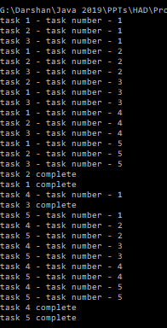
Example Executable Framework
import java.util.concurrent.*;
public class ExecutorThreadDemo {
public static void main(String[] args) {
Runnable r1 = new Task("task 1");
Runnable r2 = new Task("task 2");
Runnable r3 = new Task("task 3");
Runnable r4 = new Task("task 4");
Runnable r5 = new Task("task 5");
ExecutorService pool = Executors.newFixedThreadPool(3);
pool.execute(r1);
pool.execute(r2);
pool.execute(r3);
pool.execute(r4);
pool.execute(r5);
pool.shutdown();
}
}

Slide 55
Thread Synchronization
When we start two or more threads within a program, there may be a situation when multiple threads try to access the same resource and finally they can produce unforeseen result due to concurrency issues.
For example, if multiple threads try to write within a same file then they may corrupt the data because one of the threads can override data or while one thread is opening the same file at the same time another thread might be closing the same file.
So there is a need to synchronize the action of multiple threads and make sure that only one thread can access the resource at a given point in time.
Java programming language provides a very handy way of creating threads and synchronizing their task by using synchronized methods & synchronized blocks.

Slide 56
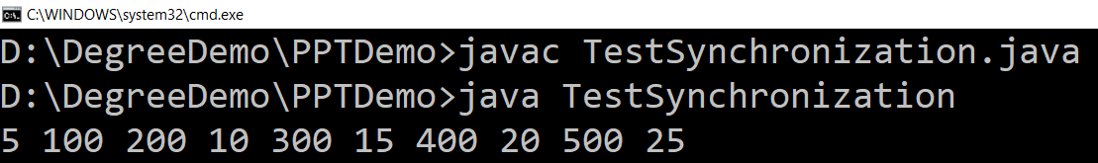
Problem without synchronization (Example)
class Table {
void printTable(int n) { for (int i = 1; i <= 5; i++) {
System.out.print(n * i + " ");
try {
Thread.sleep(400);
} catch (Exception e) {
System.out.println(e);
}
}
}
}
class MyThread1 extends Thread {
Table t;
MyThread1(Table t) {
this.t = t;
}
public void run() {
t.printTable(5);
}
}
class MyThread2 extends Thread {
Table t;
MyThread2(Table t) {
this.t = t;
}
public void run() {
t.printTable(100);
}
}
public class TestSynchronization {
public static void main(String args[]){
Table obj = new Table();
MyThread1 t1 = new MyThread1(obj);
MyThread2 t2 = new MyThread2(obj);
t1.start();
t2.start();
}
}

Slide 57
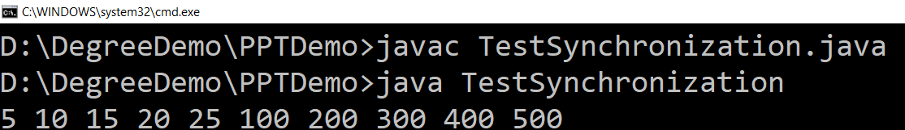
Solution with synchronized method
class Table {
synchronized void printTable(int n) { for (int i = 1; i <= 5; i++) {
System.out.print(n * i + " ");
try {
Thread.sleep(400);
} catch (Exception e) {
System.out.println(e);
}
}
}
}
class MyThread1 extends Thread {
Table t;
MyThread1(Table t) {
this.t = t;
}
public void run() {
t.printTable(5);
}
}
class MyThread2 extends Thread {
Table t;
MyThread2(Table t) {
this.t = t;
}
public void run() {
t.printTable(100);
}
}
public class TestSynchronization {
public static void main(String args[]){
Table obj = new Table();
MyThread1 t1 = new MyThread1(obj);
MyThread2 t2 = new MyThread2(obj);
t1.start();
t2.start();
}
}

Slide 58
Solution with synchronized blocks
class Table {
void printTable(int n) { for (int i = 1; i <= 5; i++) {
System.out.print(n * i + " ");
try {
Thread.sleep(400);
} catch (Exception e) {
System.out.println(e);
}
}
}
}
class MyThread1 extends Thread {
Table t;
MyThread1(Table t) {
this.t = t;
}
public void run() {
synchronized (t) {
t.printTable(5);
}
}
}
class MyThread2 extends Thread {
Table t;
MyThread1(Table t) {
this.t = t;
}
public void run() {
synchronized (t) {
t.printTable(100);
}
}
}
public class TestSynchronization {
public static void main(String args[]){
Table obj = new Table();
MyThread1 t1 = new MyThread1(obj);
MyThread2 t2 = new MyThread2(obj);
t1.start();
t2.start();
}
}

Slide 59
Thread priority
Each thread has a priority.
Priorities are represented by a number between 1 and 10.
Thread priorities are integers that specify the relative priority of one thread to another.
In most cases, the thread scheduler schedules the threads according to their priority (known as preemptive scheduling). But it is not guaranteed because it depends on JVM specification that which scheduling it chooses.
Thread Priority Methods | Description
public final int getPriority() | java.lang.Thread.getPriority() method returns the priority of the given thread.
public final void setPriority(int newPriority) | java.lang.Thread.setPriority() method updates or assign the priority of the thread to newPriority. The method throws IllegalArgumentException if the value newPriority goes out of the range, which is 1 (minimum) to 10 (maximum).

Slide 60
Thread priority Constants
Thread Constants | Value
public static int MIN_PRIORITY | 1
public static int NORM_PRIORITY | 5
public static int MAX_PRIORITY | 10

Slide 61
Multithreading: Producer_Consumer Program
class MyProdConsmeTH{
public static void main(String[] args) {
Prod product=new Prod();
MyProduce p=new MyProduce(product);
MyConsum c=new MyConsum(product);
}
}
class Product{
int item;
synchronized public void put(int item){
this.item=item;
System.out.println("Put:"+item);
}
synchronized public int get(){
System.out.println("Get:"+item);
return item;
}
}

Slide 62
Multithreading: Producer_Consumer Program
class Consume1 extends Thread{
Product1 p1;
int g;
Consume1(Product1 p1){
this.p1=p1;
start();
}
public void run(){
for(int i=0;i<5;i++){
g=p1.get();
try{
Thread.sleep(500);
}catch(Exception e){
System.out.println("inside exp");
}}}}
class Produce1 extends Thread{
Product1 p1;
Produce1(Product1 p1){
this.p1=p1;
start();
}
public void run(){
for(int i=0;i<5;i++){
p1.put(i);
try{
Thread.sleep(500);
}catch(Exception e){
System.out.println("inside exp");
}
}}}

Slide 63
Thank You

